Slide 1
Lecture 11
Looking inside Cities: Spatial Structure and Neighborhoods
11.2 Models of Neighborhood Segregation, Real Estate Dynamics.
© Luís M. A. Bettencourt 2024
Notes:
This module brings up a few additional ideas and data, but it could be skipped. It presents some interesting dynamics, data, and suggestion for discussions.

Slide 2
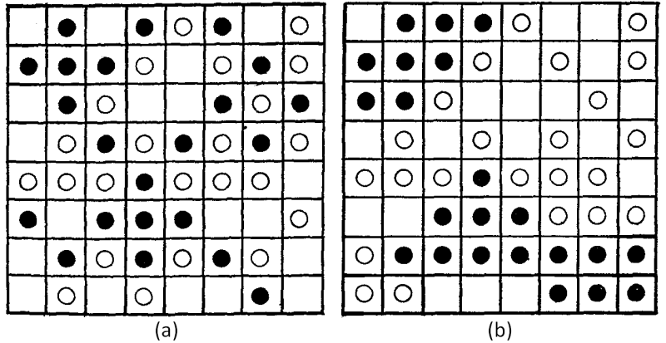
Schelling Classical Model of Residential Segregation
IUS 6.1.2
Rules:
1) Agents belong to one of two groups
2) Decision to relocate according to the fraction of friends (i.e., agents of their own group).
3) An agent, located where the fraction of friends f is less than a predefined tolerance threshold F (i.e., f < F),
will relocate to a neighborhood for which the fraction of friends is at least f
F~1/3
can be small
small preferences can have huge consequences for global dynamics
Schelling 1971
https://www.tandfonline.com/doi/abs/10.1080/0022250X.1971.9989794
Notes:
First, we briefly discuss a famous model of segregation due to Schelling. This is a very crude and simplistic model, but it has been used a lot in the literature and so it should be mentioned and discussed. It assumes that people do not want to be in a racial minority among their local neighbors and will move (at no cost) to avoid that situation. Mathematically, it is related to spin models in statistical physics. Over time this local rule typically produces city-wide segregated areas which are each locally more homogeneous. The point is to show that simple local rules can lead to unintended emerging outcomes, without the need for explicit global politics or control.

Slide 3
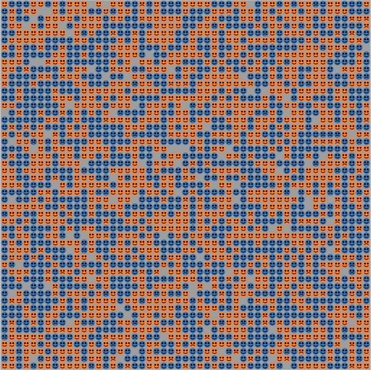
Time Evolution Schelling Model
credit: Michael Maes via youtube
Notes:
This is a video showing the model running… It is a model where the number of agents of each type is conserved, and where alignment with the same type of preferred neighbors is assumed to be preferred (this latter part is similar to ferromagnet alignment in a spin model of physics, the difference to such models are the non-local rules of movement).

Slide 4
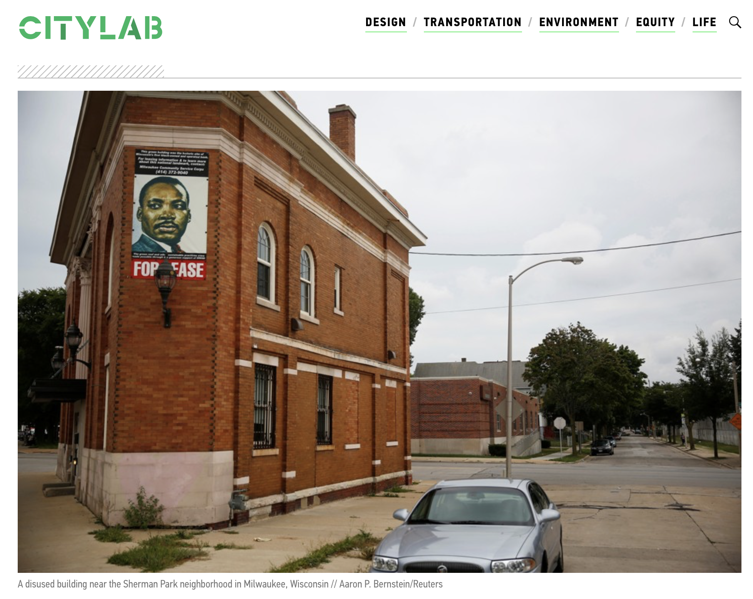
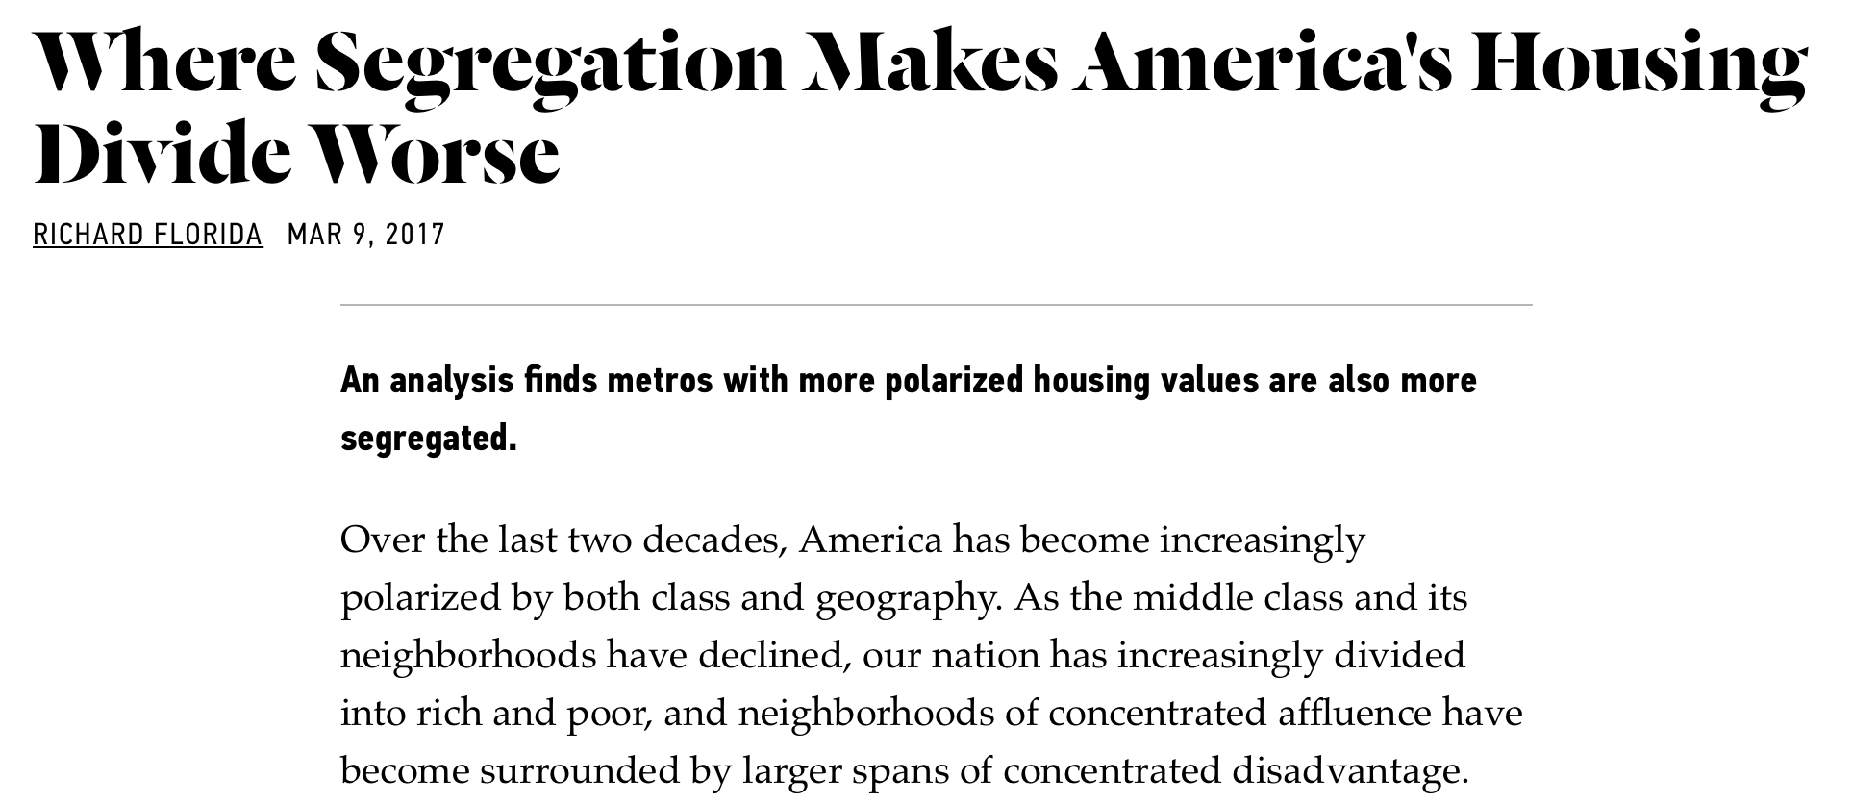
Spatially concentrated (dis)advantage
Notes:
A related issue that would be worth a whole lecture series is housing. Most economic segregation is mediated through housing types, contracts that exclude, access to credit, prices, and so on. When housing is completely privatized, exclusion becomes typically common; One the other hand, many public housing programs were also designed to segregate populations. The dynamics of housing and its “unforeseen” consequences became substantially worse in the last 20 years in US cities, as housing became a more speculative financial asset, and airbnb and others came into the housing market.

Slide 5
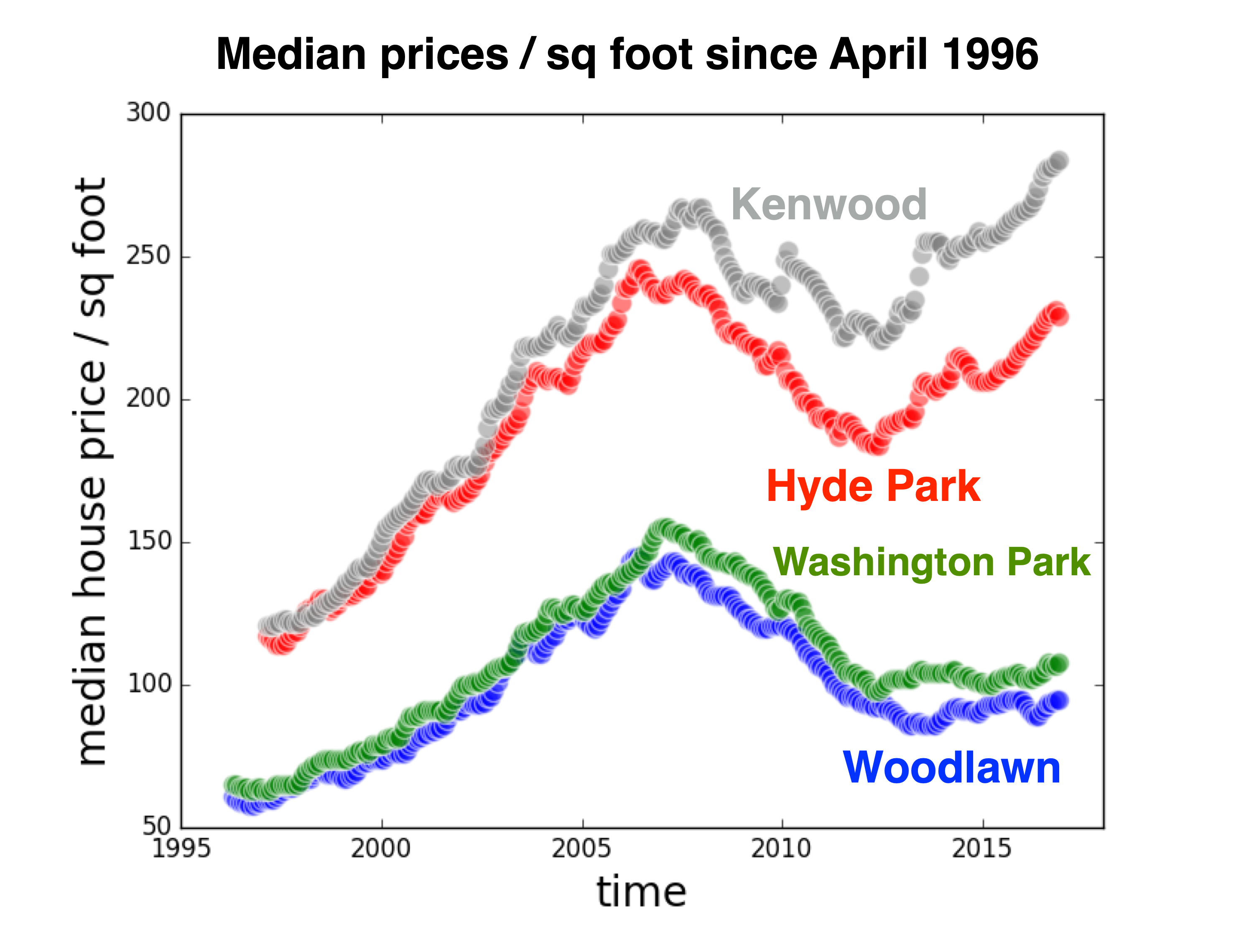
Monthly data from zillow
Notes:
The economics of housing are fascinating and troubling: Here are the price evolution since 1996 in the 4 neighborhoods around the University of Chicago: two are relatively rich and two quite poor. This history is very interesting, if you know Chicago. Note how the rich neighborhood suffer less from the economic downturn (presumably because they can better hold their assets) and recovers sooner. As a result, inequality is larger after boom and bust and boom again, than initially. These trends need better theory and modeling.

Slide 6
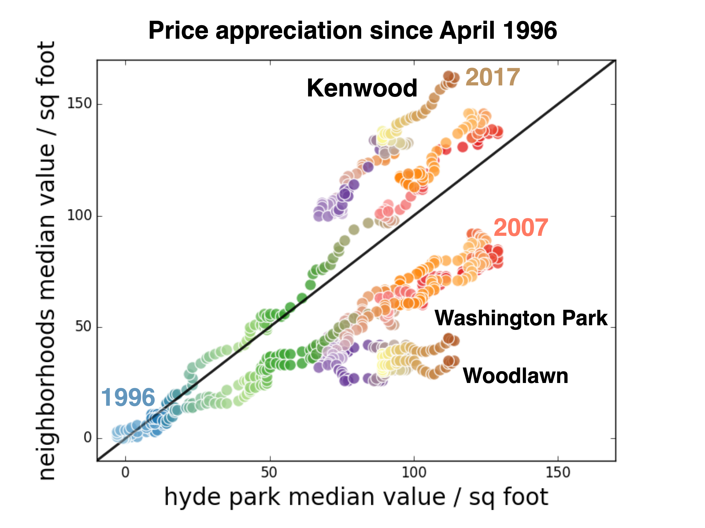
Notes:
This is a different way to show the data with Hyde Park (the central neighborhood for the University) as the reference. The rich get richer and the poor get poorer peeling away from the diagonal (Hyde Park). Note the 2007-8 housing crisis and the sharp increase in inequality in house values that followed.

Slide 7
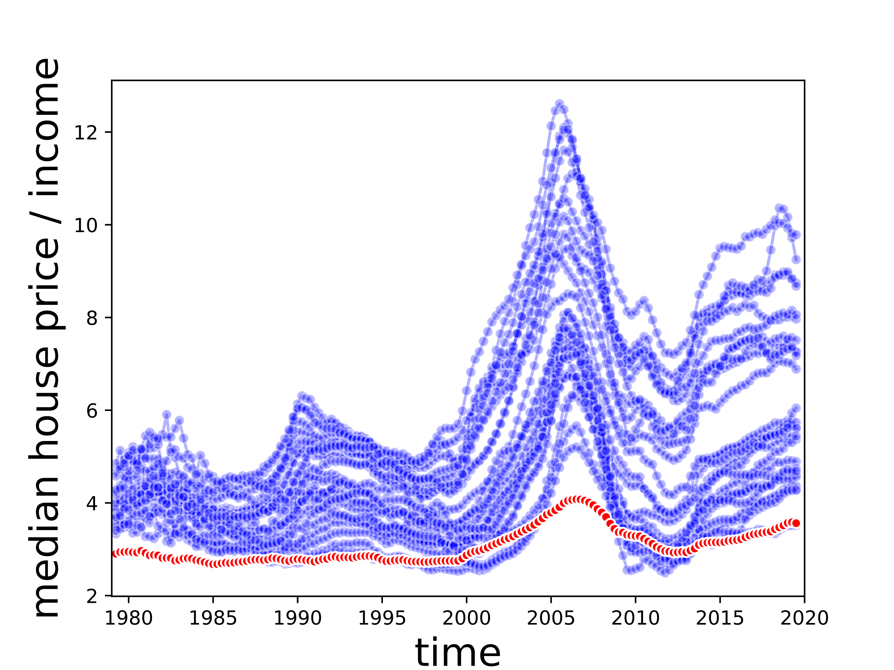

Affordability of CA Metros vs Nation
Lowest Affordability Metros:
Santa Cruz
San Jose
Los Angeles
San Francisco
San Luis Obispo
Santa Barbara
national metro average
Notes:
And this is California. Incredible… really. Affordability is the ratio of median house prices to median income, shown in the yy axis. Of course no one lives on the median …

Slide 8
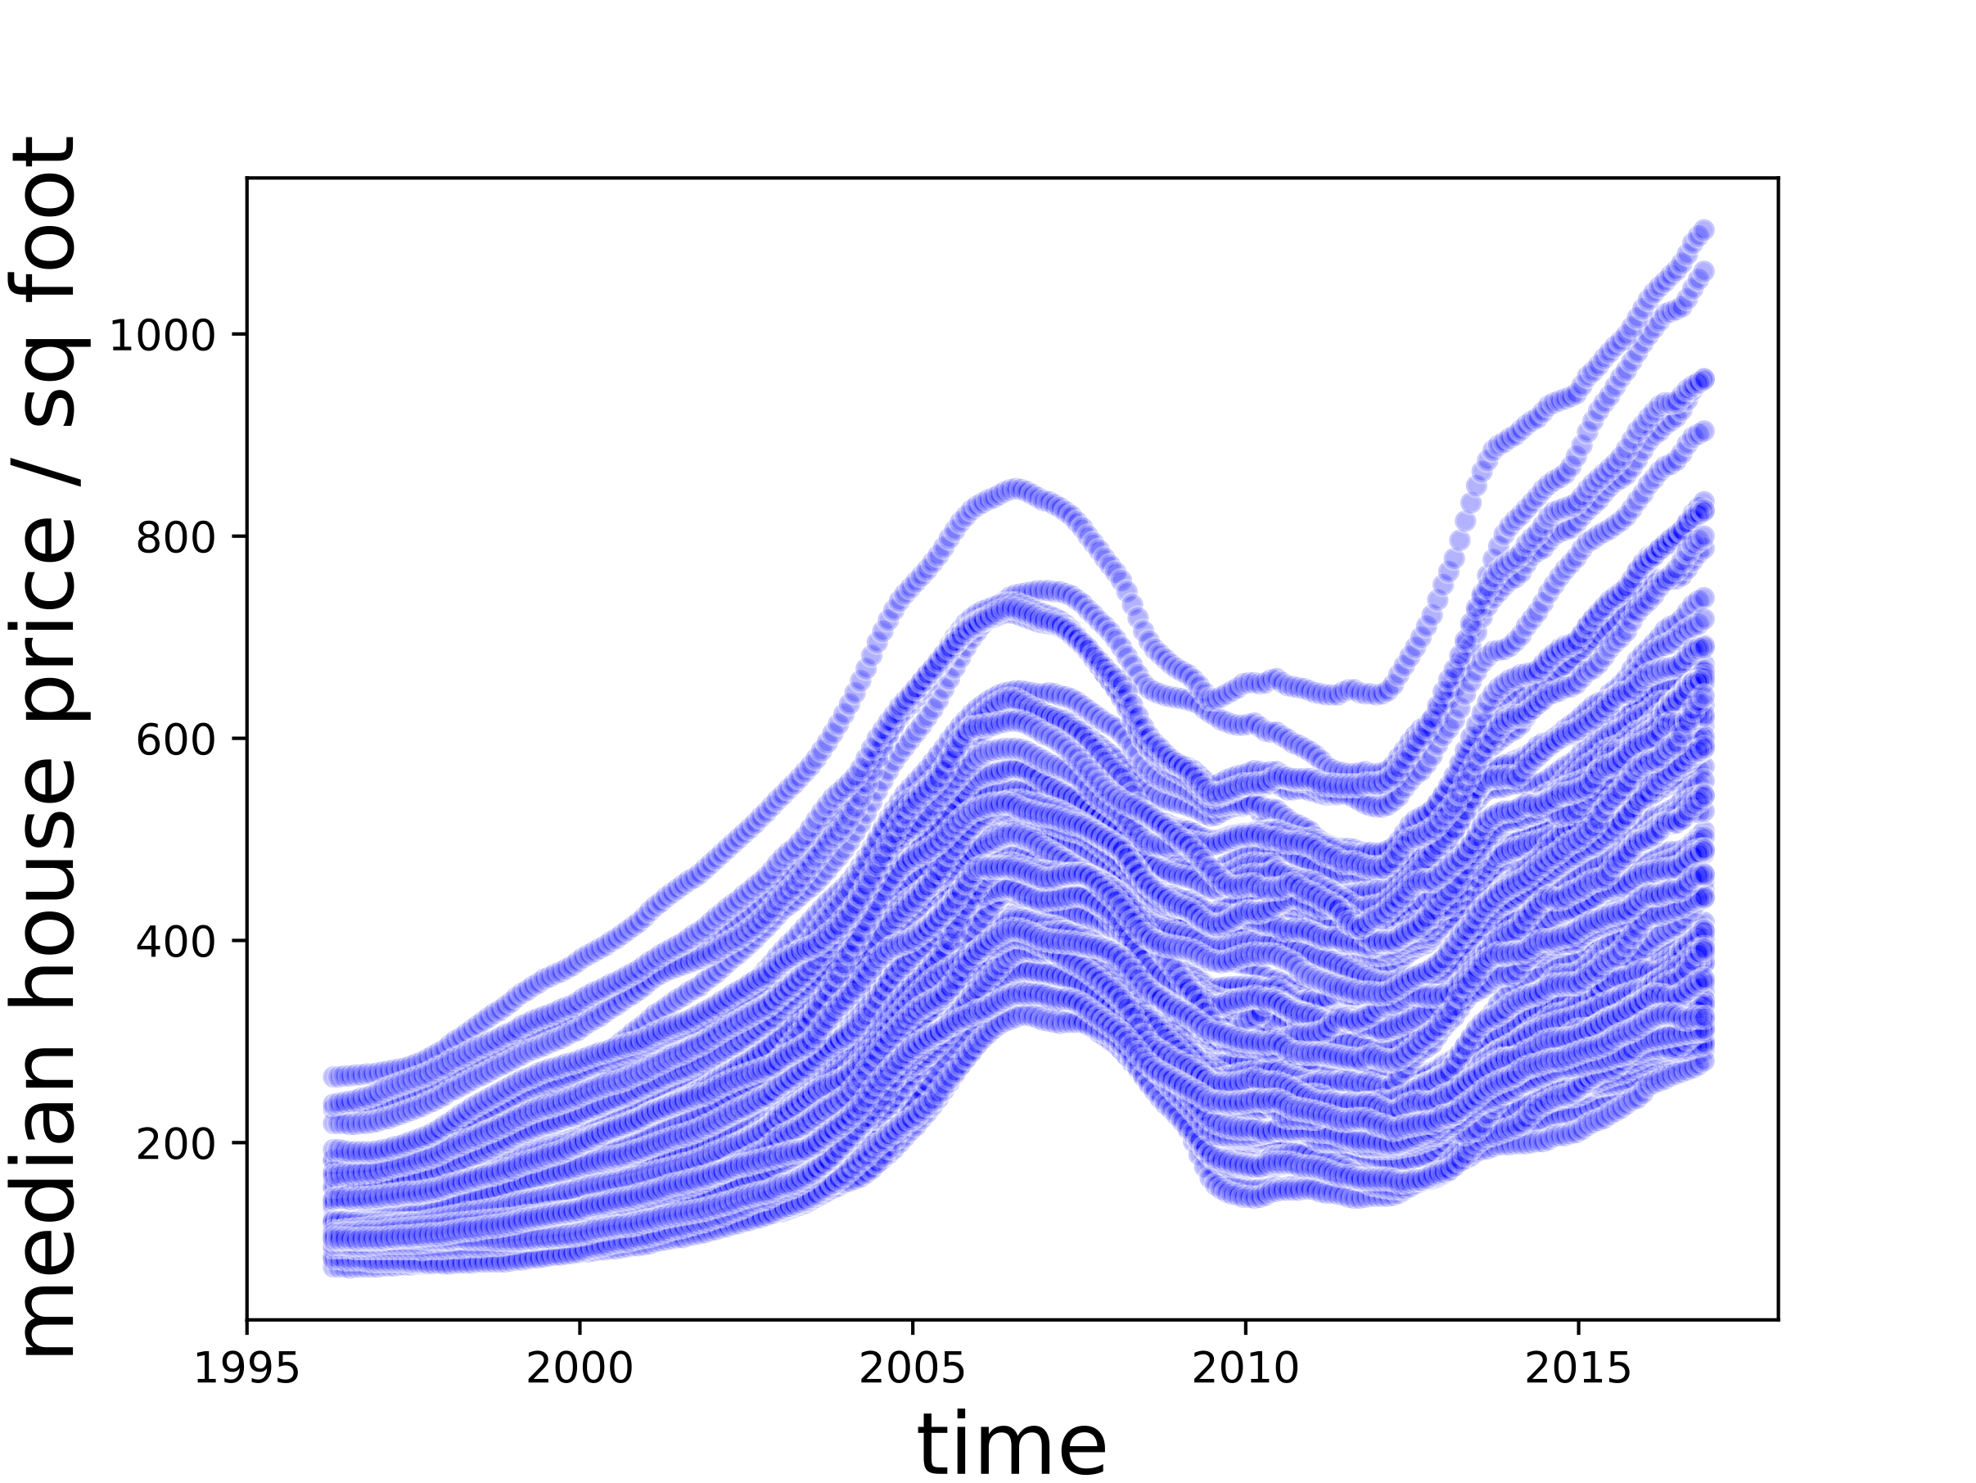
Neighborhoods
Pacific Palisades
City of Los Angeles
Venice
Bel Air
Beverlywood
Panorama City
Sylmar
Central City
Notes:
Similar dynamics, where the rich get richer… and the poorer lag (though notice also som appreciation) at the neighborhood level within LA (and any other city). Inequality rises. This is all Zillow data, which I believe has since become non-available.

Slide 9
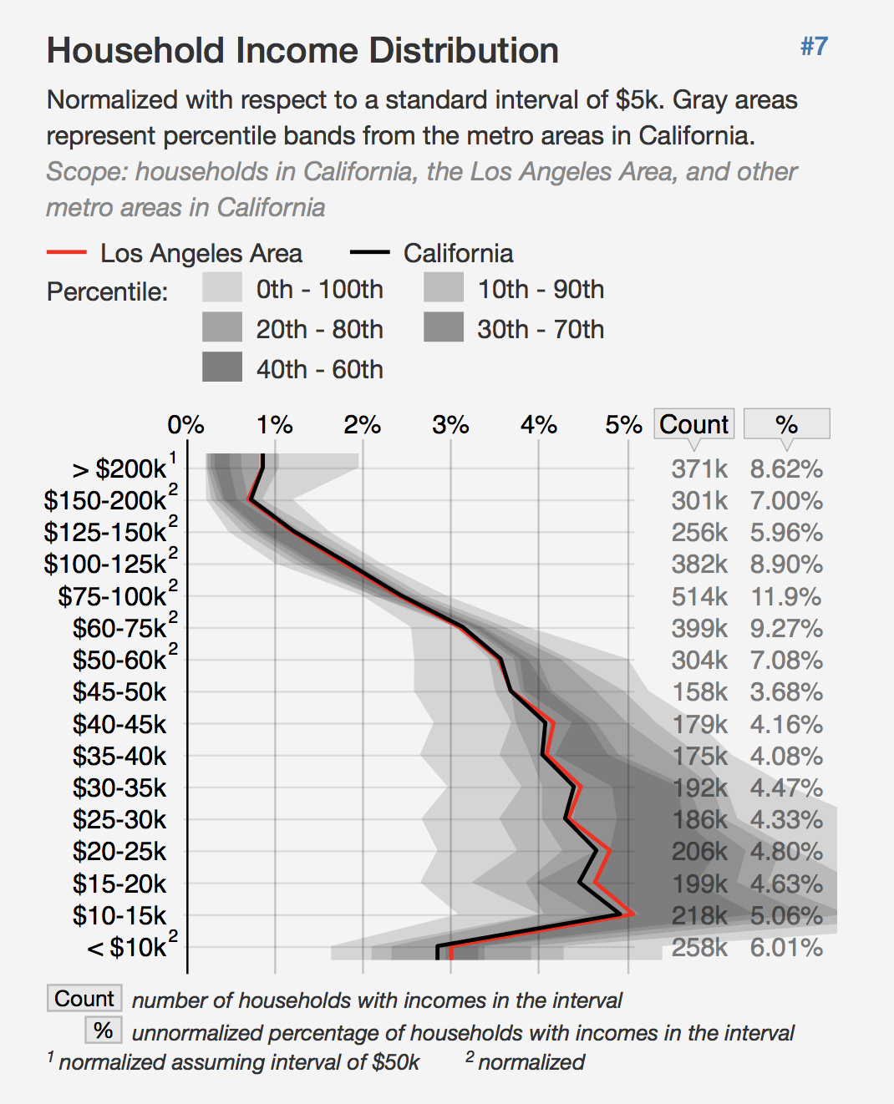
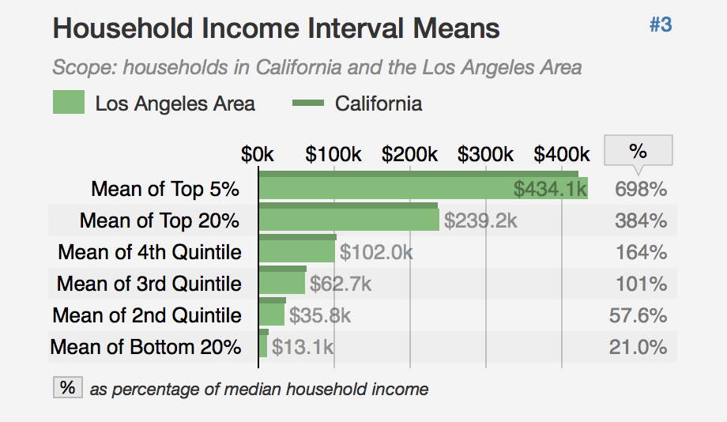
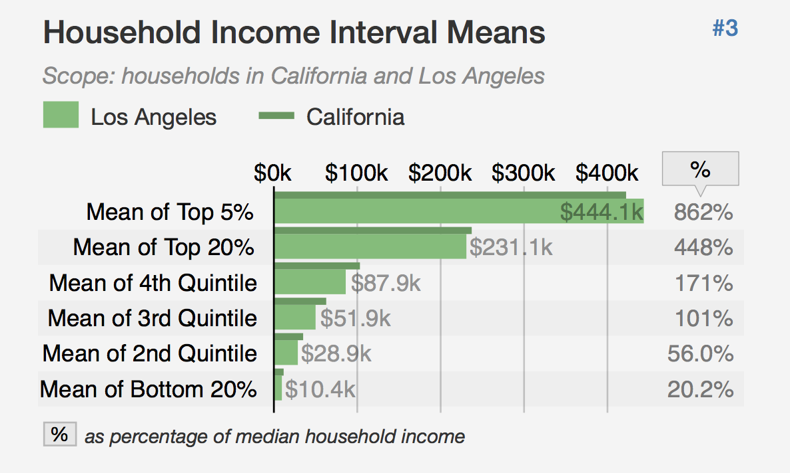

Los Angeles Metropolitan Area
City of Los Angeles
20%
~2 million people
$52K/year/12 x 0.4=$1733/month
back of envelope rent estimate:
~50% population
$20K/year/12 x 0.4 =$667/month
~20% population
assuming 40% income expenditure in housing
Notes:
This shows how unaffordable housing is in LA. It is a “rule of thumb” that the 20% lowest income households cannot afford market housing. For a meeting with people from various organizations in CA, I estimated some numbers for what they can afford in LA. Unaffordability leads to crowding and homelessness, triggering a host of many other challenges. All this has gotten worse since this was done around 2019. You should play with these distributions and reach your own estimates.

